Slide 1
Submit Work Orders
SchoolDude Request

Slide 2
Submit a Work Order Form
Go to the My Allegheny home page
On the right hand side under College Resources select “Forms”
Under forms, under Physical Plant, click “Work Order Form”
Complete the Work Order through SchoolDude

Slide 3
Signing into Schooldude
When signing in please use your Allegheny email and password

Slide 4
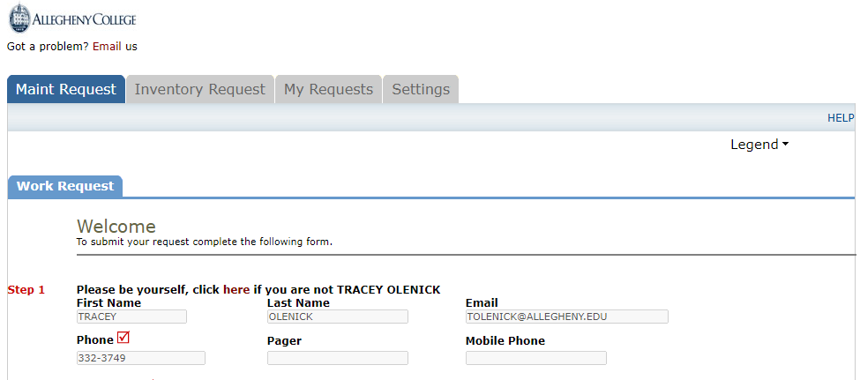
Step 1.
This section should populate from your login credentials.

Slide 5
Step 2.
Please choose a location from the list. Make sure to select an area (1st floor, 2nd floor, basement, etc.) and include the room number or area use in the Area/Room Number box if applicable.

Slide 6
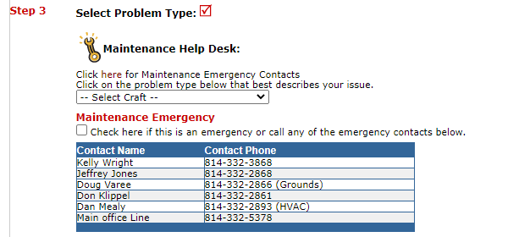
Step 3. and Step 4.
Select the type of work to be done from the drop down “Craft” menu
Check the box if the request is an emergency
Provide additional detail about the request (be as specific as possible)

Slide 7
Step 5. and Step 6.
Select Purpose from the drop down menu. Your choices are:
COVID 19
General Ground
General Maintenance
Housekeeping
Other
Vandalism
Attach a photo or layout if needed

Slide 8
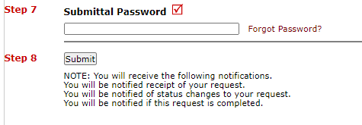
Steps 7. and Step 8.
Type the submittal password: “Gator”
When the work order is complete you will receive the notifications noted above

Slide 9
Finding Your Maintenance Requests

