Slide 1
COVID PPE Supplies
SchoolDude Inventory Request

Slide 2
Submit a PPE Supply Request
Go to the My Allegheny home page
On the right hand side under College Resources select “Forms”
Under forms, under Physical Plant, click “PPE Supply Request”
Complete the Request through SchoolDude

Slide 3
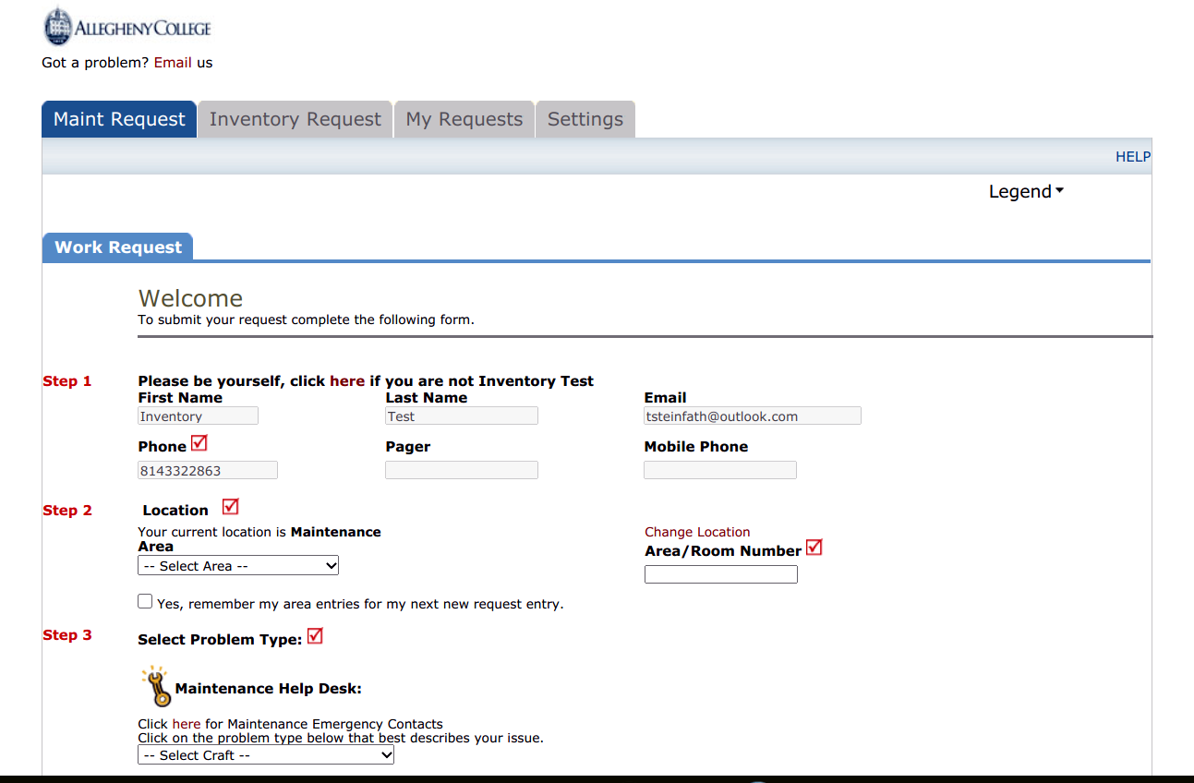
Sign into your Schooldude Account You now have a new “Inventory Request” tab

Slide 4
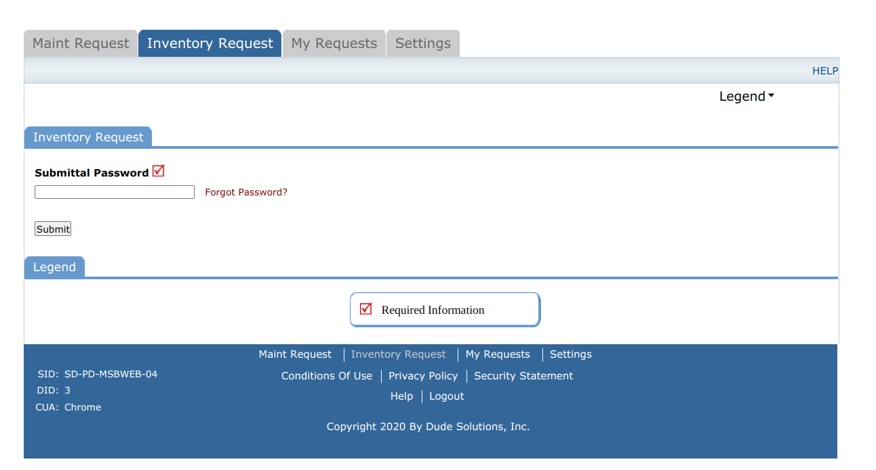
Password Submittal Your password is “password”
You will be prompted to change your password in your initial email notification

Slide 5
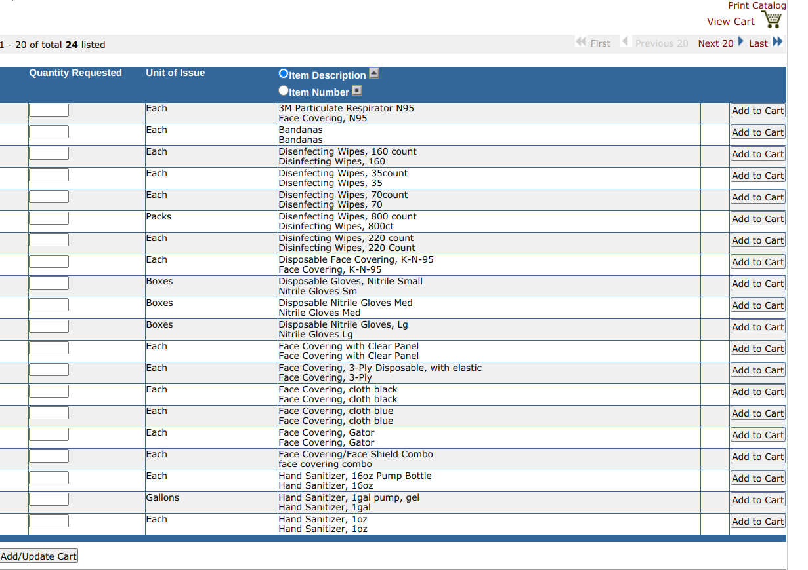
Fill in Quantity Request, then add to cart Click on View Cart to complete your request
Click on “Next 20” to see additional screens

Slide 6
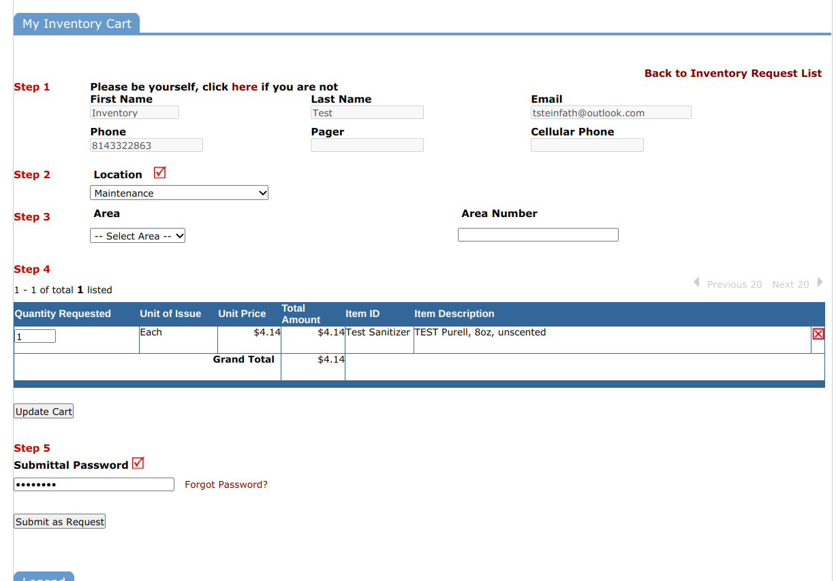
Review your Request Click “submit as Request”
Make sure your Location is Correct
You do not need to fill in Area (Step 3)

Slide 7
Request Approval
Request approval will be at the discretion of the Inventory Control Coordinator and Logistics Team with guidance from your AEC member when needed.
You may be contacted for additional information.
Request Status can be seen via the My Requests tab (see next 2 slides)
Once approved, you will be contacted to arrange pick up from the Loomis Street parking lot.
Other arrangements may need to be made depending on unique situations that are likely to happen during this pandemic

Slide 8
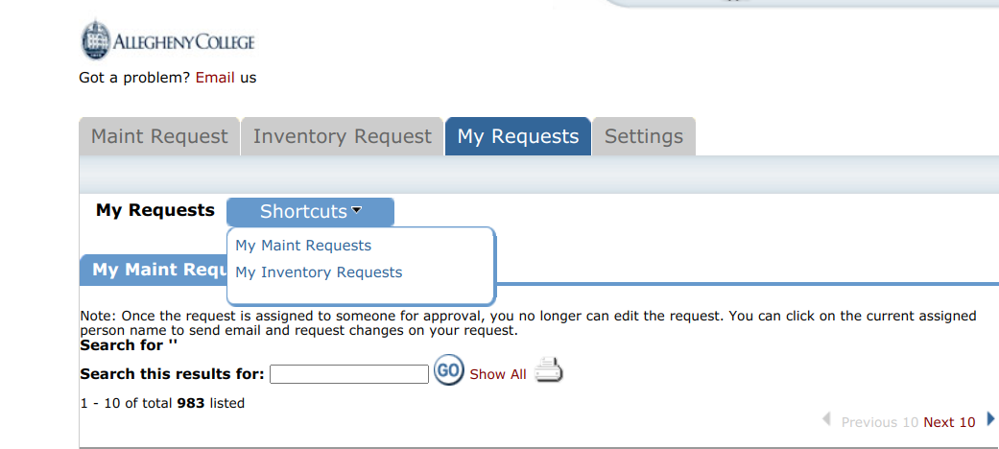
Finding Your Inventory Requests

Slide 9
Your Inventory Requests

Slide 10
Please Note
Only Building Coordinators are being assigned as Inventory Requesters at this time.
Building Coordinators will notify their department about these procedures.
Requests should be made with an understanding that the availability and cost of supplies have been significantly disrupted by the COVID-19 pandemic.
Request approval will be at the discretion of the Inventory Control Coordinator with guidance from the work of the Allegheny College Health Agency (ACHA), the Pandemic Operational Groups, and your AEC member.
Additional information may be requested.

Slide 11
For more information Contact:
Tammy Steinfath tsteinfath@allegheny.edu x2863
Kelly Boulton kboulton@allegheny.edu

